Slide 1

Directional Sound Speakers
'A' Speaker : that only 'YOU ' can hear

Slide 2
Noise Pollution
Noise pollution, also known as environmental noise or sound pollution, is the propagation of noise with harmful impact on the activity of human or animal life.
The source of outdoor noise worldwide is mainly caused by machines, transport and transportation systems. Poor urban planning may give rise to noise pollution, side-by-side industrial and residential buildings can result in noise pollution in the residential areas

Slide 3
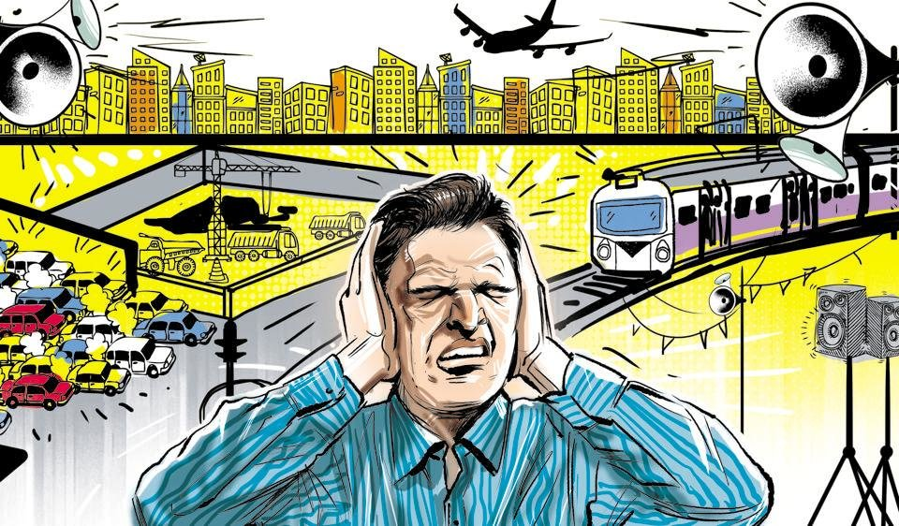
Noise Pollution

Slide 4
Noise Pollution
High noise levels can contribute to cardiovascular effects in humans and an increased incidence of coronary artery disease.
In animals, noise can increase the risk of death by altering predator or prey detection and avoidance, interfere with reproduction and navigation, and contribute to permanent hearing loss.

Slide 5
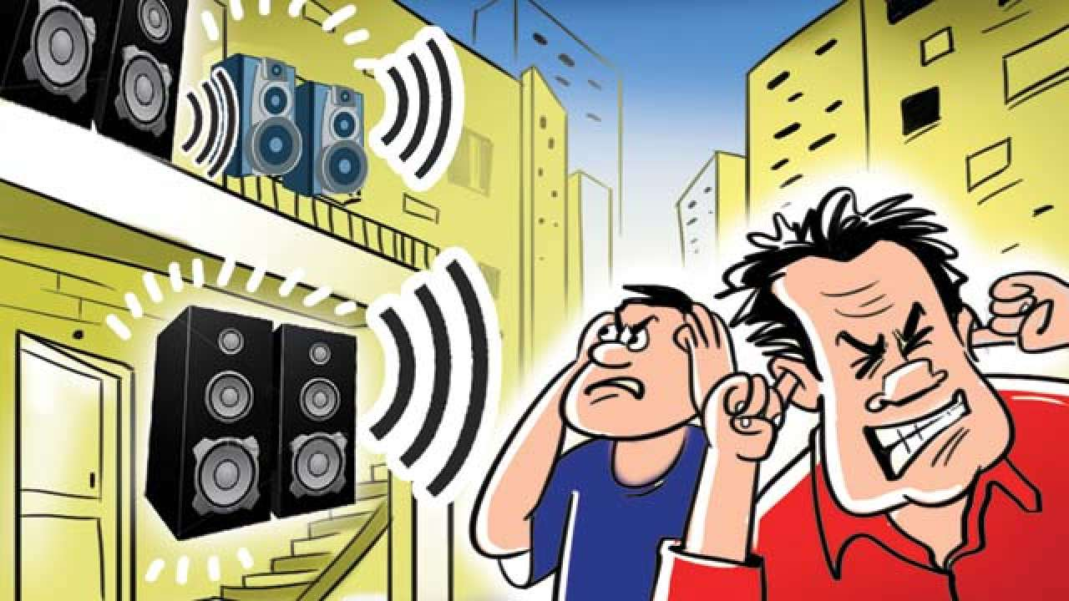

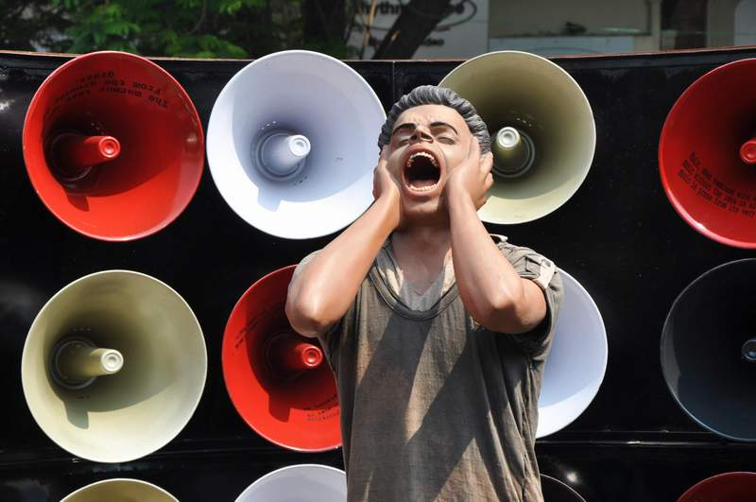

Effects of Noise Pollution

Slide 6

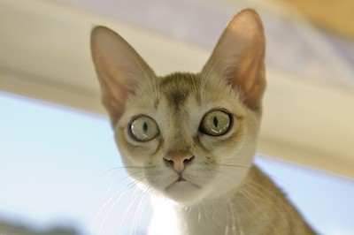
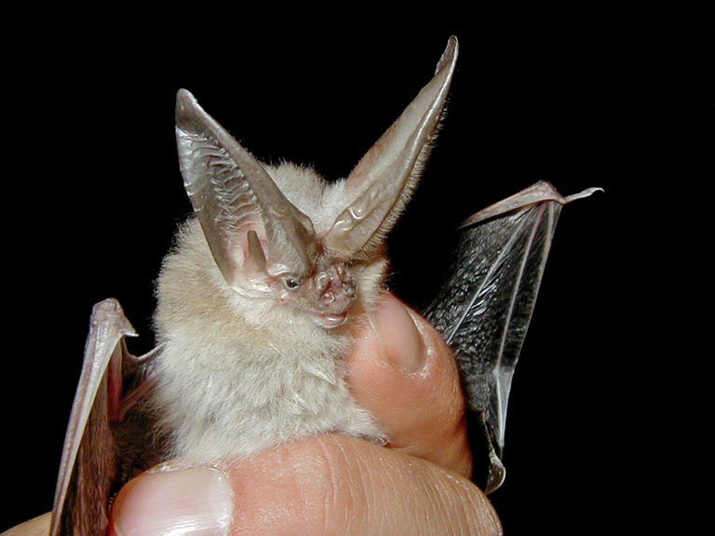
Effects of Noise Pollution on Animals

Slide 7
Effects of Noise pollution on Children & senior citizens
While the elderly may have cardiac problems due to noise, according to the World Health Organization, children are especially vulnerable to noise, and the effects that noise has on children may be permanent.
Noise poses a serious threat to a child’s physical and psychological health, and may negatively interfere with a child's learning and behaviour.

Slide 8

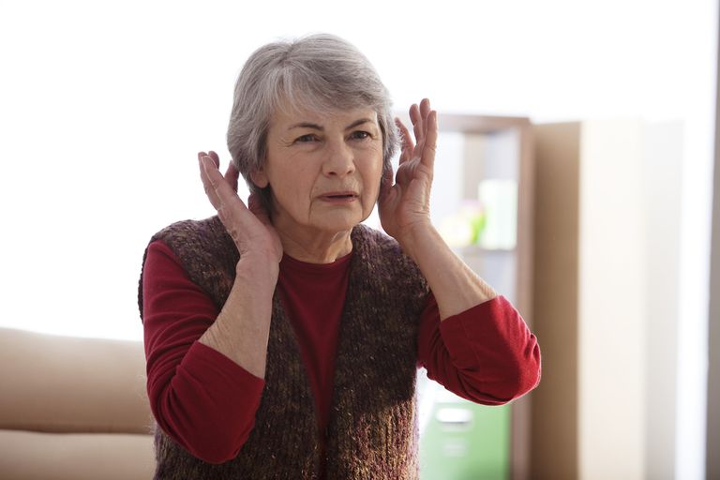

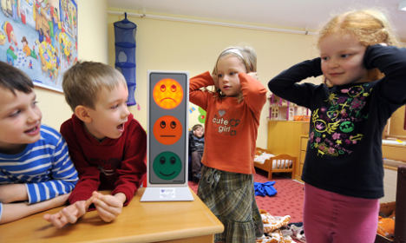
Effects of Noise pollution on Children & senior citizens

Slide 9
Health
Noise pollution affects both health and behaviour.
Unwanted sound (noise) can damage physiological health. Noise pollution can cause hypertension, high stress levels, tinnitus, hearing loss, sleep disturbances, and other harmful effects.

Slide 10
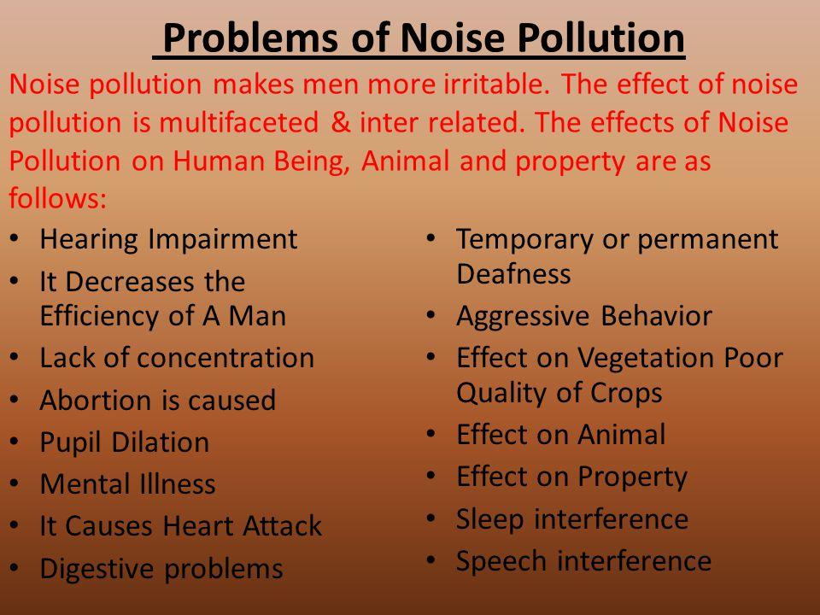
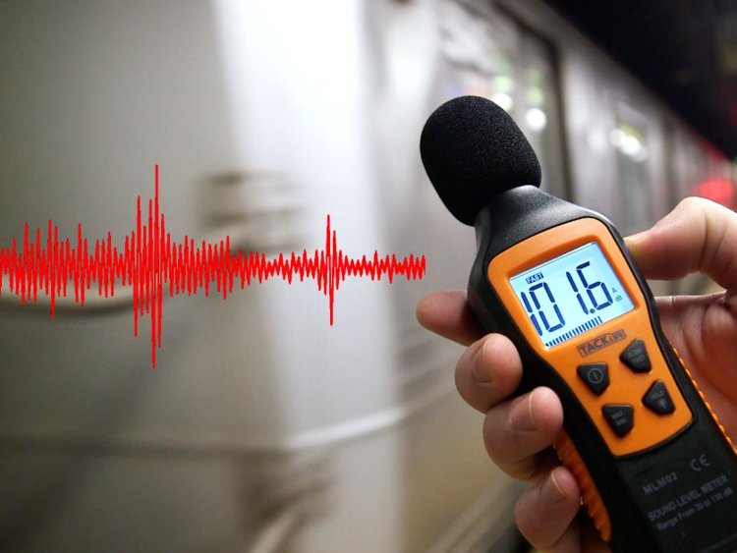
Noise pollution affects both health and behaviour

Slide 11
Noise pollution affects both health and behaviour
Sound becomes unwanted when it either interferes with normal activities such as sleep or conversation, or disrupts or diminishes one's quality of life.
Noise-induced hearing loss can be caused by prolonged exposure to noise levels above 85 A-weighted, decibels

Slide 12
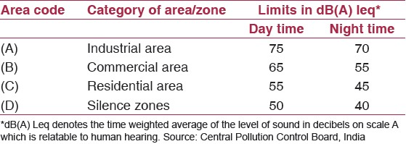
Noise Pollution Permissible Standards

Slide 13
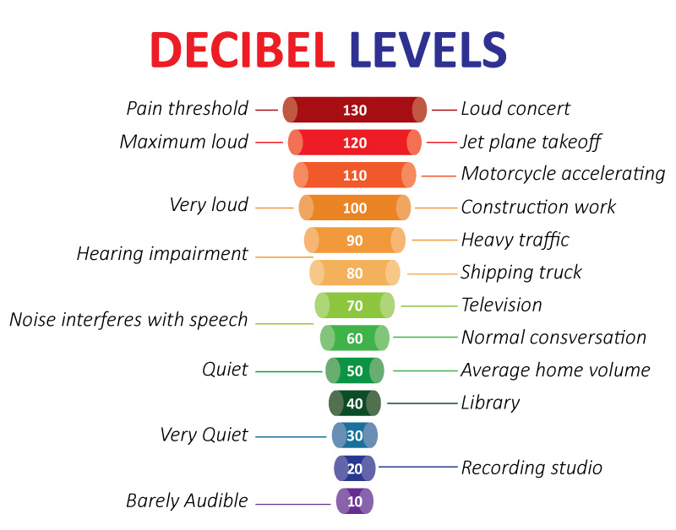
Noise Pollution Threshold Level

Slide 14
Noise pollution during festivals
The noise in Navratri makes our windows shake'
Sight of activists recording noise pollution levels during events is quite normal. But this Navratri, many Citizens have taken to monitoring decibel levels via mobile phone applications

Slide 15
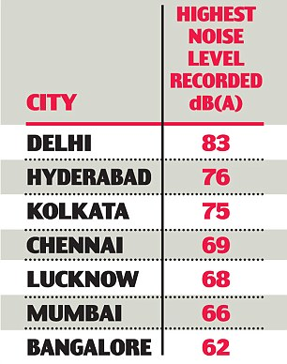

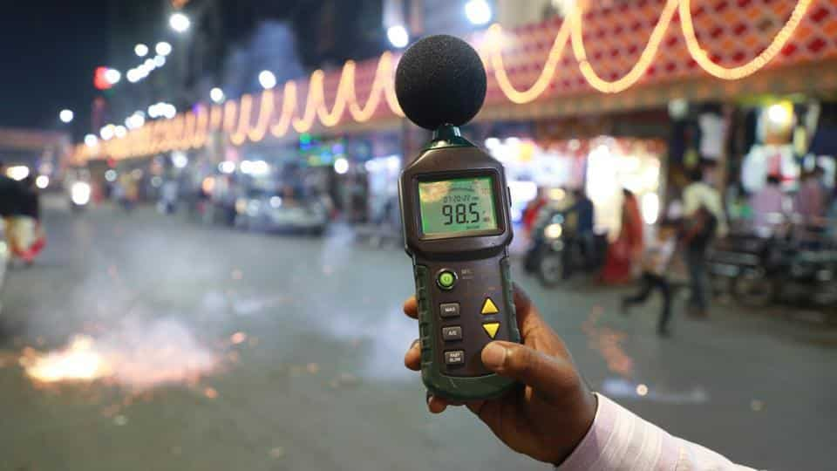
Noise pollution during festivals

Slide 16
Noise pollution during festivals
Citizens across the city recorded noise levels between 82 and 100 decibel during Navratri festival, much higher than the permissible limit of 55 db.
Festivals like Ganeshotsav and Navratri are getting noisier by the year. The sounds of dhol-tasha have been combined with recorded music blaring from loudspeakers in public places. In Navratri, live music too reaches the decibel levels of recorded music via loudspeakers, with thousands dancing to the tunes at Garba celebrations.

Slide 17

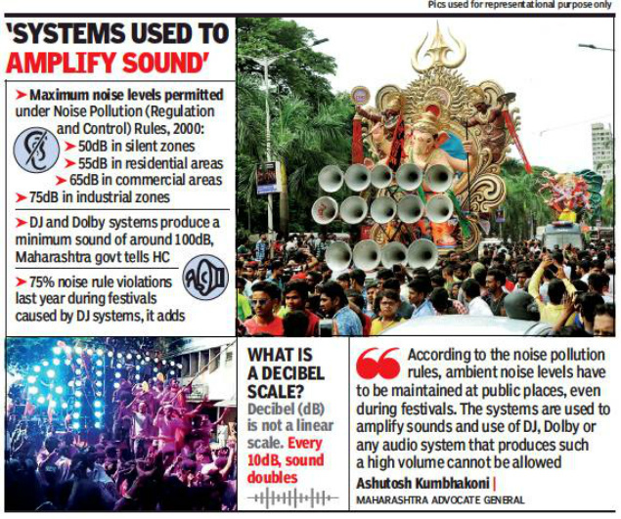
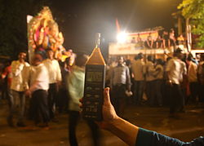
Noise pollution during festivals

Slide 18
Noise pollution during festivals
Noise Pollution in Diwali
After the celebration of durgapuja, dusserah, it comes Diwali with it’s new style and custom. The problem is that the new style is full of crackers, not the lights which causes air and sound pollution. Modern music system gives this problem an extra edge.
Any sound above 85 DB has the potential to harm our ears. Do you know, the sound level during diwali is in between 140-175 DB, a range that is high enough to cause permanent hearing damage.

Slide 19
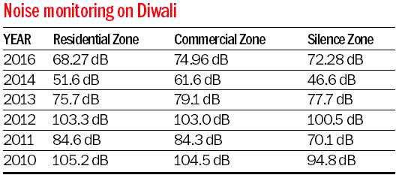

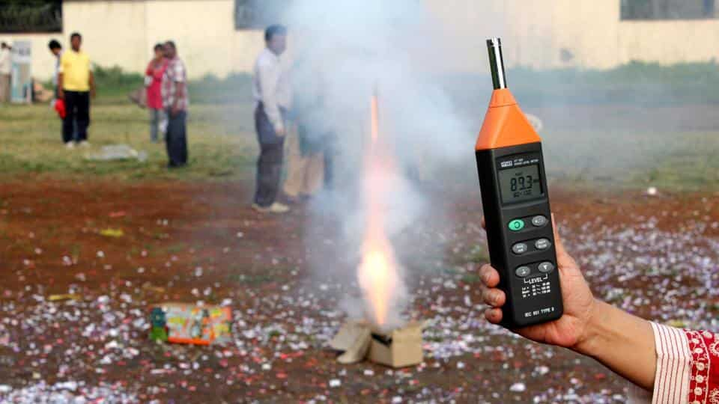
Noise Pollution During Festivals

Slide 20

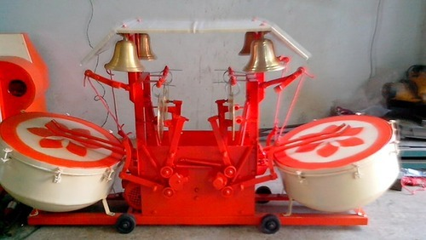
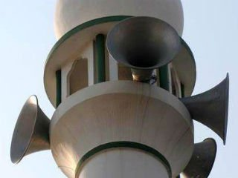
Noise Pollution During Religious Activities

Slide 21
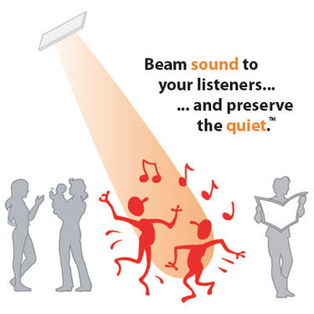


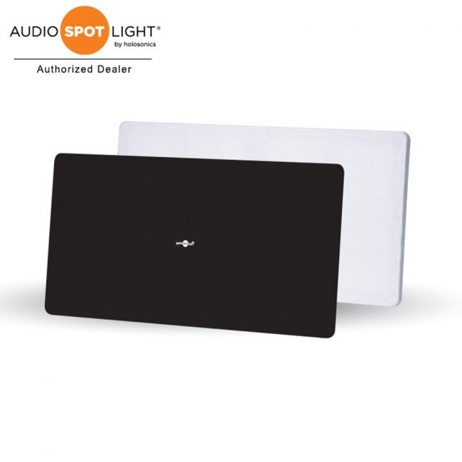
Solution

Slide 22
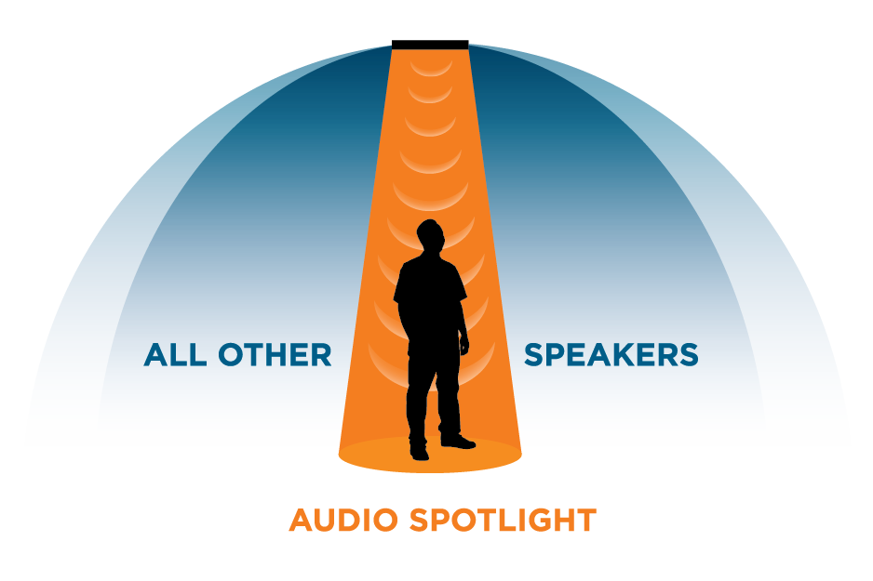
Solution

Slide 23
Directional Sound
Directional Sound refers to the notion of using various devices to create fields of sound which spread less than most (small) traditional loudspeakers.
Several techniques are available to accomplish this, and each has its benefits and drawbacks.

Slide 24
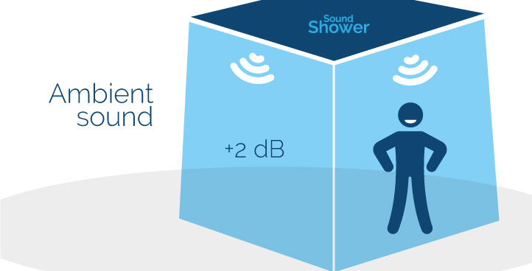
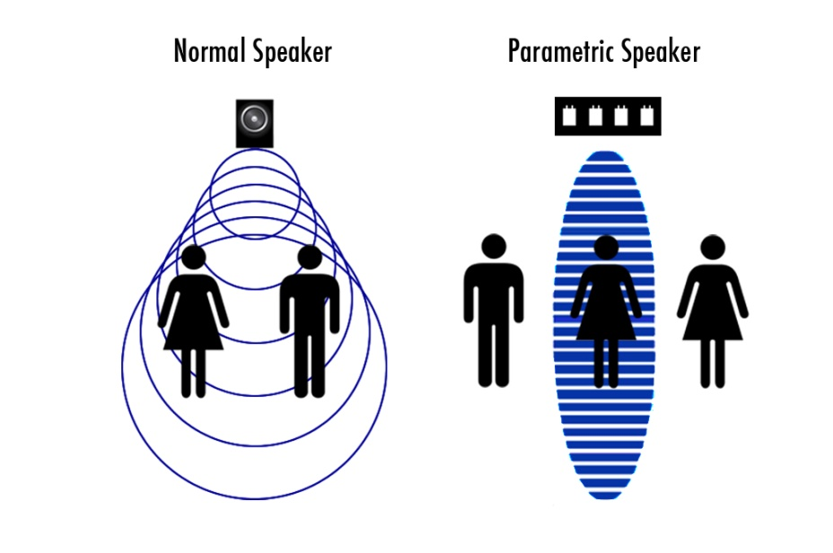
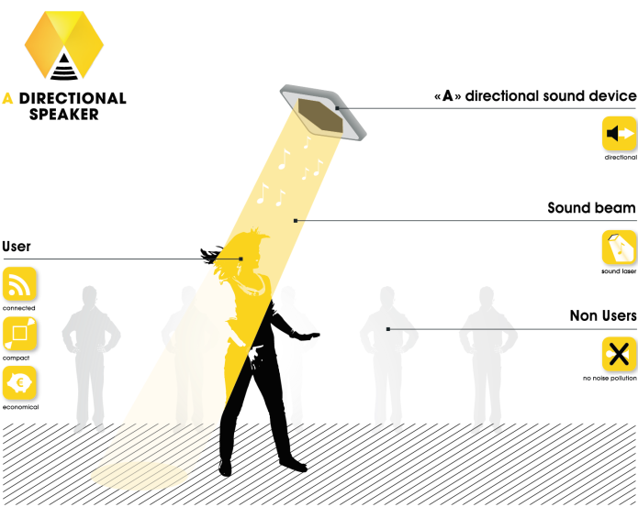
Directional Sound

Slide 25
Directional Sound
Ultimately, choosing a directional sound device depends greatly on the environment in which it is deployed as well as the content that will be reproduced.
Keeping these factors in mind will yield the best results through any evaluation of directional sound technologies.

Slide 26
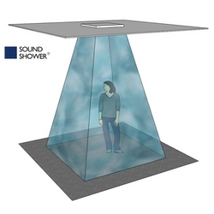
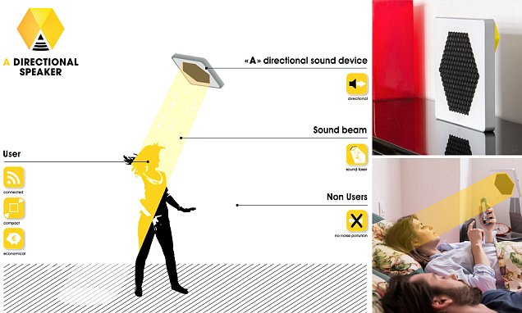
Directional Sound

Slide 27
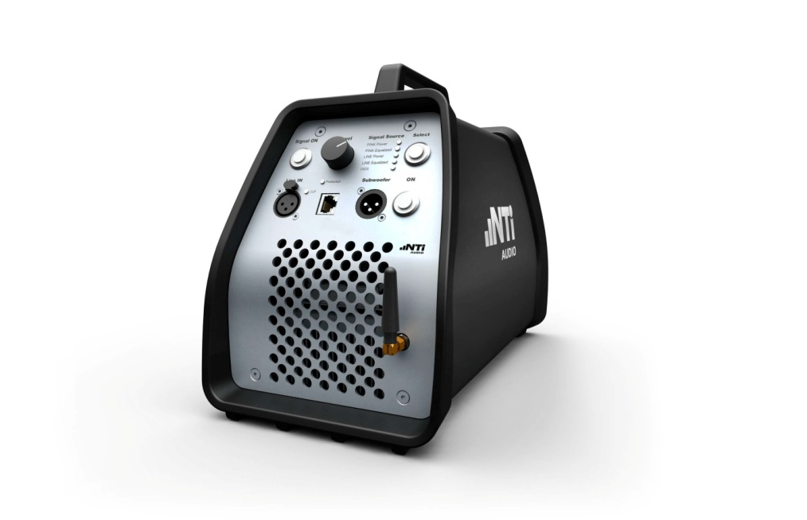
Directional Sound
Systems which guide evacuees during an emergency by the emission of pink noise to the exits are often also called "directional sound" systems.

Slide 28
Basic theory
In all wave-producing sources, the directivity of any source, at maximum, corresponds to the size of the source compared to the wavelengths it is generating:
The larger the source is compared to the wavelength of the sound waves, the more directional beam results The specific transduction method has no impact on the directivity of the resulting sound field; the analysis relies only on the aperture function of the source, per the Huygens–Fresnel principle.

Slide 29
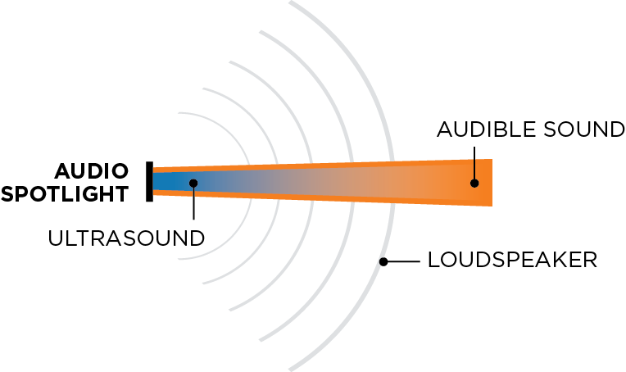
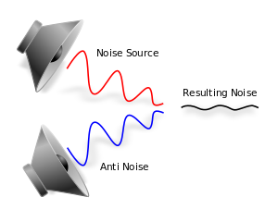
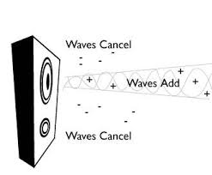
Basic theory

Slide 30
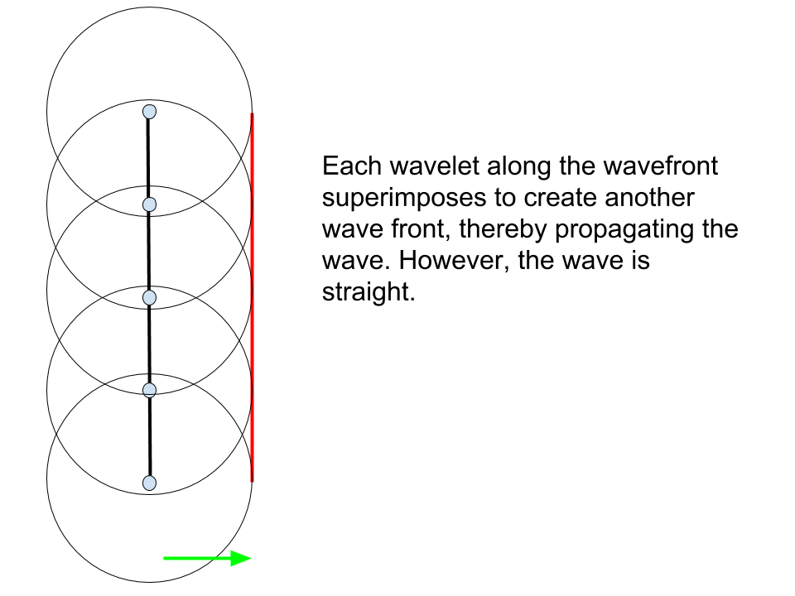
Huygens–Fresnel principle

Slide 31
Basic theory
The ultrasonic devices achieve high directivity by modulating audible sound onto high frequency ultrasound.
The higher frequency sound waves have a shorter wavelength and thus don't spread out as rapidly. For this reason, the resulting directivity of these devices is far higher than physically possible with any loudspeaker system. However, they are reported to have limited low-frequency reproduction abilities.

Slide 32
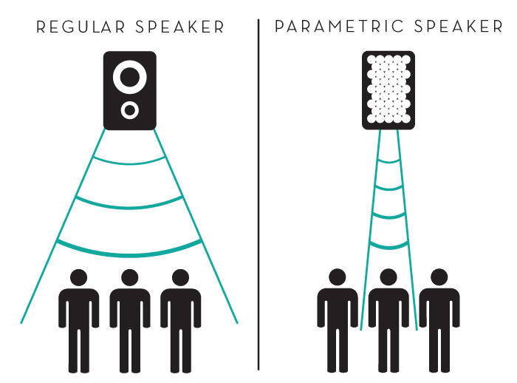
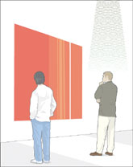
Directional Sound

Slide 33
What is a directional loudspeaker?
A conventional loudspeaker is designed to spread sound over a fairly wide area: it has a paper or plastic cone that moves back and forth, pumping sound in a wide arc in front of it. The more energy you feed into a speaker (in the form of electric current), the more energy it can pump out as sound, the further the sound waves can travel, and the louder they seem to be. Giant speakers used at rock festivals produce so much energy that they can be heard over a huge area, whether you want to hear them or not.

Slide 34
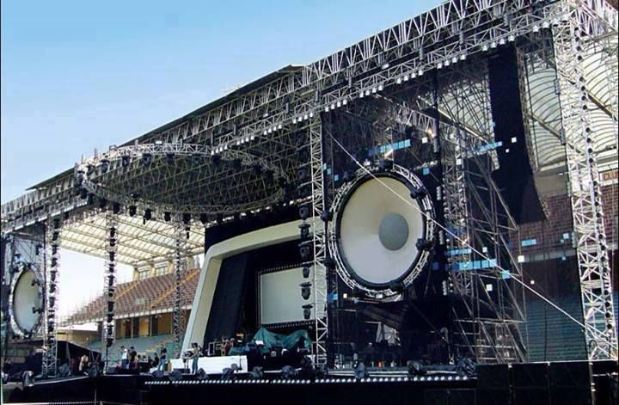
Giant speakers used at rock festivals produce so much energy that they can be heard over a huge area, whether you want to hear them or not.

Slide 35
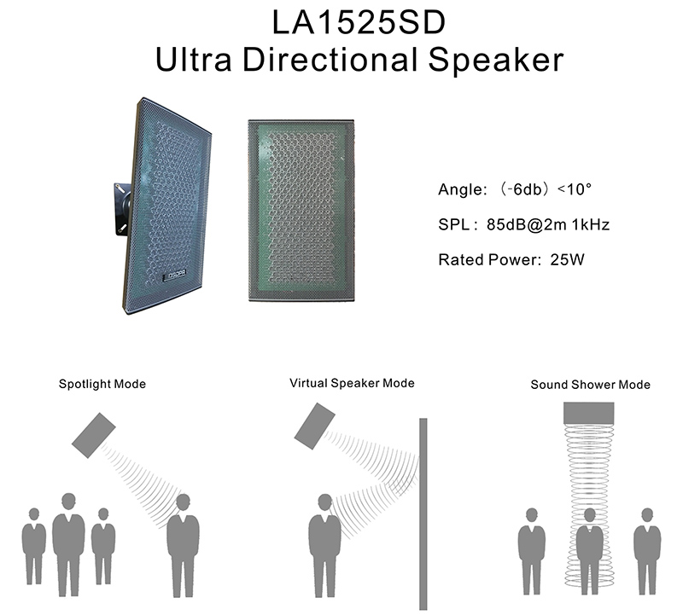
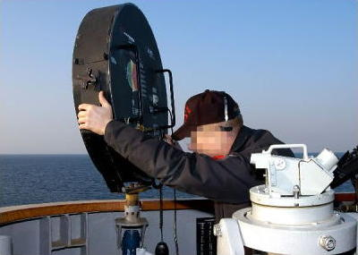
What is a directional loudspeaker?

Slide 36
What is a directional loudspeaker?
Most of the time this is exactly how we want speakers to behave, but there are times when it would be helpful if they could work more selectively. Suppose you're the captain of a giant, fast-moving warship and you see a tiny fishing boat moored just up ahead and locked firmly in your path. If it doesn't respond to radio contact, you have a problem. You could use a megaphone to try to call out, but that's just a basic loudspeaker, really, and the sound it makes will probably not reach far enough. Wouldn't it be neat if you could send out a very focused "shout," in a tight beam of sound, that would travel all the way to the fishing boat to catch its attention, even from a huge distance away? This is essentially what a directional loudspeaker does: it's a kind of "sound flashlight" that can "shine" sound energy into a precise spot, even from some distance away.

Slide 37

What is a directional loudspeaker?

Slide 38
How directional speakers work—in simple terms
You've seen ripples spreading out when you prod the surface of a still pond with your finger? That happens because the waves of energy you're putting into the water travel outward in all directions: the spreading, diverging pattern of waves is called diffraction.
The further the waves travel, the bigger the area over which their energy spreads. Eventually, the waves have so little energy that they disappear completely. Exactly the same diffraction process happens with sound waves. Whether you shout with your voice or pump sound through a loudspeaker, the sound waves spread outward from the source and their energy is gradually dissipated.

Slide 39
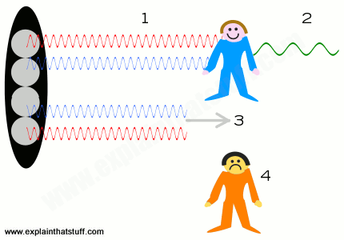
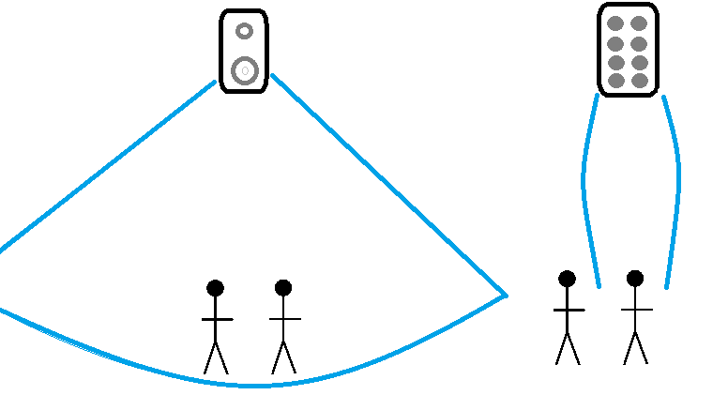
How directional speakers work—in simple terms

Slide 40
How directional speakers work—in simple terms
Directional speakers work in an entirely different way from conventional loudspeakers. The biggest difference is that they don't produce ordinary, audible sound waves with a single, moving electromagnetic coil and cone. Instead, they generate ultrasound (high-frequency sound) waves that are too high pitched for our ears to hear using an array of electrical devices called piezoelectric transducers.
These are simply crystals, such as quartz, that vibrate back and forth tens of thousands of times a second when you feed electric currents through them, producing very high frequencies of sound. Ultrasound is used because its higher-frequency waves have a correspondingly shorter wavelength and diffract (spread out) less as they travel, which means they stay together in a beam for longer than ordinary sound would.

Slide 41
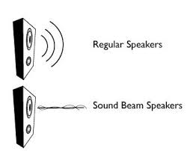
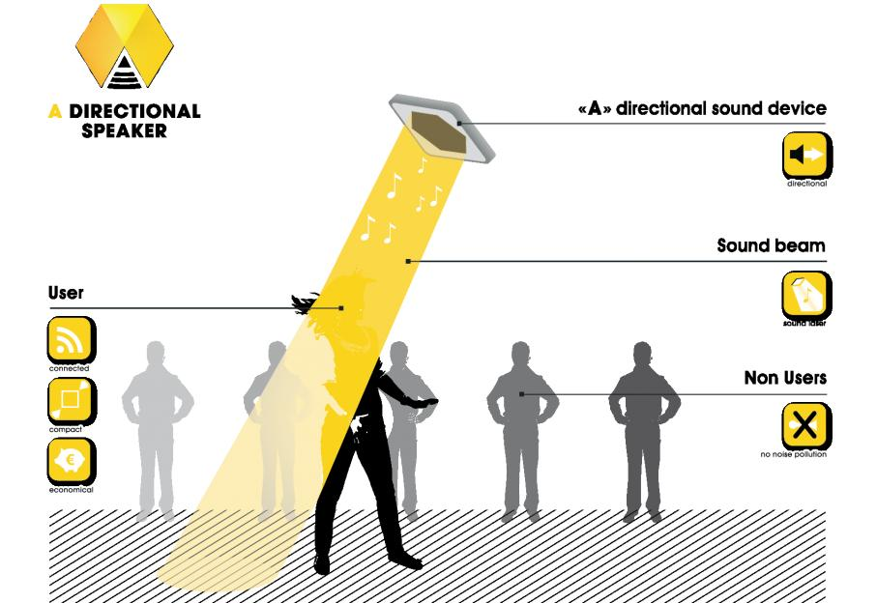
How directional speakers work—in simple terms

Slide 42
How directional speakers work—in simple terms
Effectively, then, the ultrasound travels out from a directional speaker in a narrowly focused column, like a flashlight beam. But when it hits something, it turns back into ordinary sound you can hear.
So, in the case of our talking Mona Lisa, there's a concealed directional loudspeaker next to the picture. It fires out ultrasound that travels out from the front of the picture and gradually dissipates into the room. If (and only if) someone walks into the beam, the ultrasound waves collide, turn back into normal sound, and Mona Lisa's voice is magically heard.

Slide 43
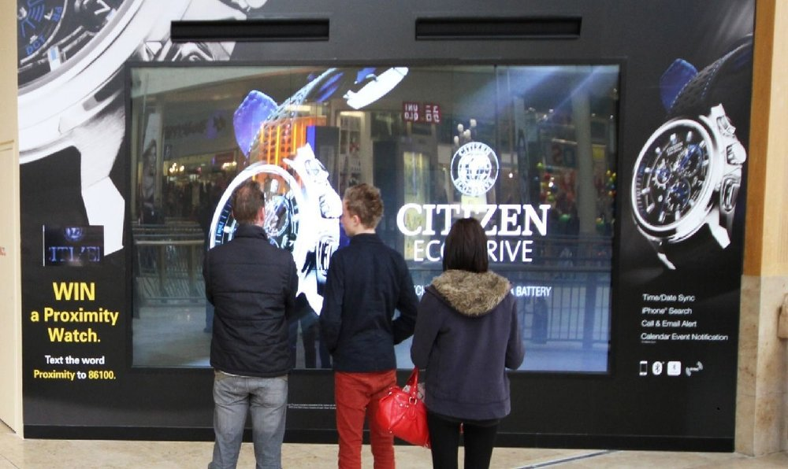
How directional speakers work—in simple terms

Slide 44
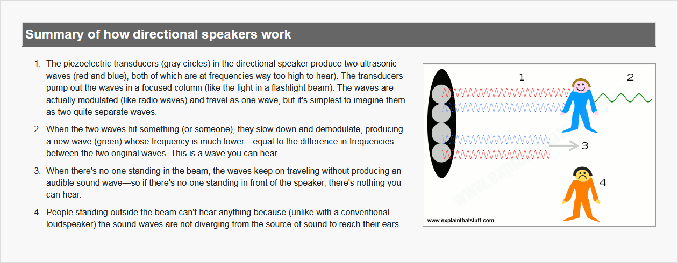
How directional speakers work—in simple terms

Slide 45
What are directional speakers used for?
The possibilities are truly limitless. Imagine advertisements or in-store displays that talk only to you as you walk past.
Or hospital televisions that beam their sound only to the patients in certain beds, leaving the others undisturbed. What about megaphones that police officers could use to address only one or two troublemakers in a rioting crowd? Or speakers on a concert stage that performers could use to send private messages to certain people in the audience! How about hands-free speaker phones that only a few people, sitting nearby, could hear? Great for noisy offices!

Slide 46
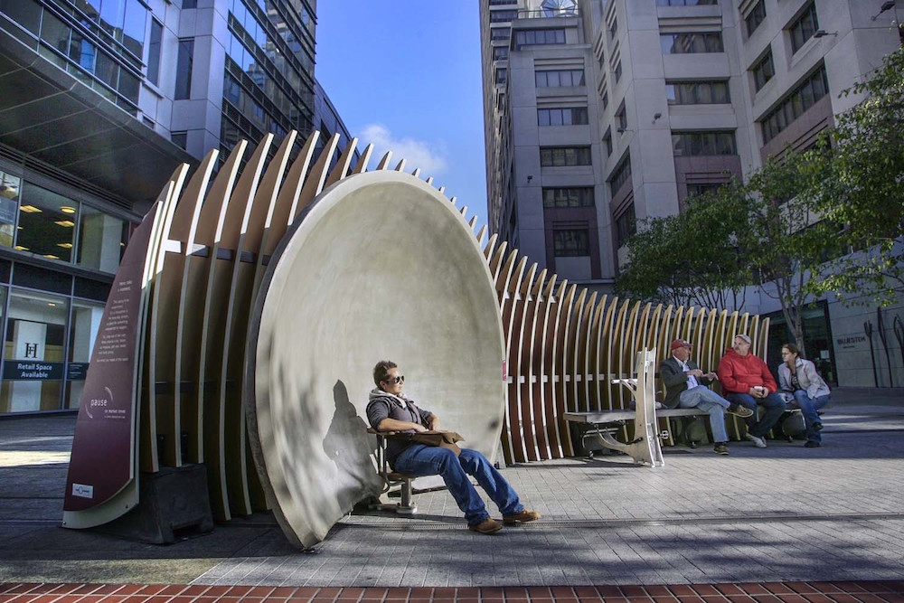
What are directional speakers used for?

Slide 47
What are directional speakers used for?
The U.S. military has been using directional speakers since 2004. The system they use is called LRAD® (long-range acoustic device) and consists of giant flat loudspeakers mounted on the side of ships so they can send loud audio warnings to vessels at a potential range of over 500m (a third of a mile).
It's particularly useful on loud and noisy aircraft carriers where any conventional loudspeaker would be drowned out by the background noise from jet planes and helicopters. Some police departments have been using LRAD as a means of crowd control for over a decade, though the practice is controversial.

Slide 48
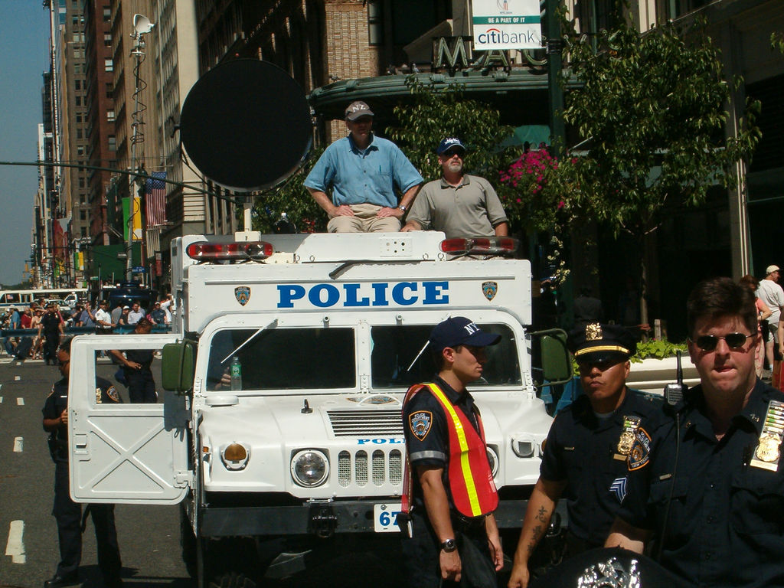
What are directional speakers used for?

Slide 49
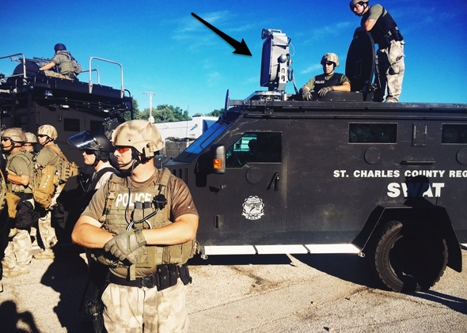
LRAD long range acoustic device sound

Slide 50
Who invented directional speakers?
The kind of directional-speaker technology we're talking about in this article was originally developed by naval scientists who were using parametric arrays with sonar (underwater navigation) systems.
One of the first people to perfect the technology for use with audible sound was US inventor Woody Norris; his system, called HyperSonic Sound (HSS)®, is marketed by LRAD Corporation (formerly called American Technology Corporation, ATC), which makes the LRAD® and a number of related products.
The Holosonics® Audio Spotlight® uses broadly similar ultrasonic technology developed by former MIT student Dr Joseph Pompei.

Slide 51
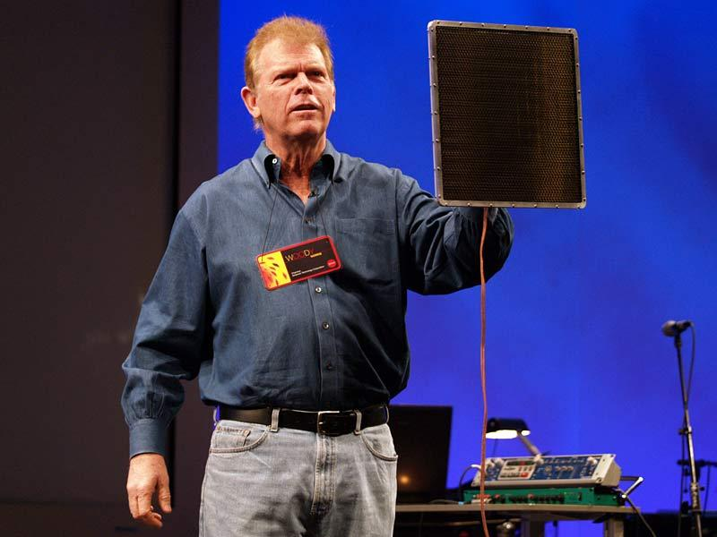
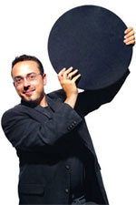
Who invented directional speakers?
US inventor Woody Norris; his system, called HyperSonic Sound (HSS)®
The Holosonics® Audio Spotlight® uses broadly similar ultrasonic technology developed by former MIT student Dr Joseph Pompei.

Slide 52
Audio Spotlight By Holosonics
Directional Sound System
The Audio Spotlight is a revolutionary new audio technology that creates sound in a narrow beam, just like light. Aim the flat, thin speaker panel to your desired listening area, and provide all of the sound and none of the noise.
Since 2000, thousands of Audio Spotlight systems have been installed in a wide range of applications around the world. From museums, exhibits, kiosks, and digital signage to retail stores and special projects, hundreds of companies have chosen this unique, patented technology to provide high-quality, precisely controlled sound, while preserving the quiet.
The Audio Spotlight range is the most directional speaker range available. They use ultrasound to create a very tight beam of sound, ideal for one listener.

Slide 53
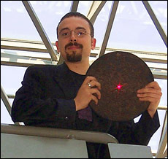
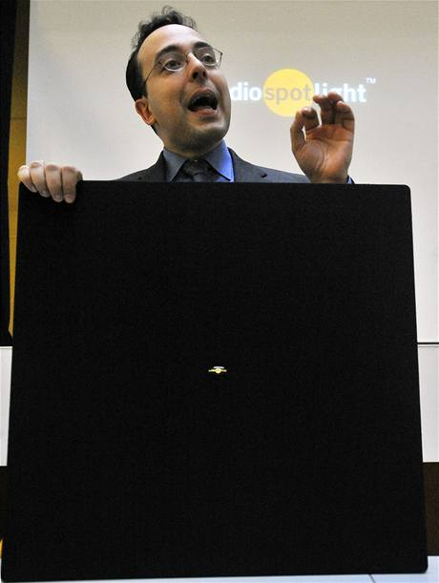
Audio Spotlight By Holosonics

Slide 54
Audio spotlight Applications
Since 2000, Audio Spotlight systems have been installed in thousands of locations around the world.
museums, exhibits, galleries and retail stores, to digital signage and special projects, the world's top companies have chosen the unique, patented Audio Spotlight directional loudspeaker technology to provide high-quality, precisely targeted sound.

Slide 55
Museums & Galleries
A serene, quiet gallery lends an air of sophistication and comfort, allowing your guests to more fully experience and enjoy their visit.
Chatter from loudspeakers can distract and disturb your guests, threatening the peaceful environment you strive to provide. Audio Spotlight systems are used by the world’s top museums to provide localized sound for those who wish to hear sound, while maintaining quiet elsewhere.

Slide 56

Battle Of Britain Memorial

Slide 57
Museums & Galleries
ADVANTAGES
Sound for specific displays - and quiet elsewhere.
Several soundtracks in one room - without disturbing others or interfering with one another.

Slide 58

Morrison Hotel Gallery

Slide 59
Digital Signage
ADVANTAGES
Attract and excite shoppers with sound, without adding noise.
Maintain peace and quiet, while still providing sound.
"Illuminate" products with sound.
Allow multimedia in difficult or sensitive areas.

Slide 60

Digital Signage

Slide 61
Tradeshows & Events
ADVANTAGES
Amaze your guests with a unique audio experience.
Avoid a jumble of sound, even with many sources.
"Illuminate" products with sound.
Place sound only where it is wanted.

Slide 62

Tradeshows & Events

Slide 63
Creative Marketing
ADVANTAGES
Push the limits of traditional marketing.
Incorporate sound where previously not possible.
Keep your projects on the cutting edge.

Slide 64

Creative Marketing

Slide 65
Retail
ADVANTAGES
• Target specific display areas or audiences with sound • Avoid filling entire store with unpleasant noise • Simple installation with a clean, attractive look • Low cost, large potential return on investment

Slide 66

Retail

Slide 67
Libraries
Of all the quiet places in the world, libraries are the most sensitive to background noise – even quiet conversation is frowned upon. The very thought of adding sound systems to the interior of a library was considered absurd, until they tried the Audio Spotlight.

Slide 68

Libraries

Slide 69
Hospitals
ADVANTAGES
• Provide private listening for every patient • Eliminate messy, dangerous headphones • Spare the staff from being subjected to noise • Maintain peace and serenity throughout the facility

Slide 70

Hospitals

Slide 71
Consumer
The Audio Spotlight PrivateSound™ technology creates a tight, narrow beam of sound that can be controlled with the same precision as light. Aim the speaker at your desired listening area to keep sound focused specifically to your listeners and quiet everywhere else.

Slide 72

Consumer

Slide 73
Consumer
Audio Spotlight speakers are used to provide localized sound for those who wish to hear it, while maintaining quiet elsewhere. Producing a narrow beam of sound, wide enough to cover only a single person or two, the Audio Spotlight speaker allows every seat in the living room to be a different experience, and the home to be a more peaceful, and shared space.

Slide 74

Consumer

Slide 75

Consumer

Slide 76
Popular Home Applications
Limiting sound bleed in open concept layouts
Assisted listening for the hard of hearing
Bedtime TV viewing without disturbing partner
Private wake up alarms
Split screen TV with private audio for each viewer

Slide 77

Popular Home Applications

Slide 78


Popular Applications

Slide 79

Popular Applications

Slide 80

Directional Sound Speakers

Slide 81

References
Awaaz Foundation
https://en.wikipedia.org/wiki/Awaaz_Foundation
Audio Spotlight By Holosonics
https://www.holosonics.com/
Directional Sound
Https://en.wikipedia.org/wiki/Directional_sound
Directional loudspeakers
https://www.explainthatstuff.com/directional-loudspeakers.html
HyperSound
https://www.hypersoundhearing.com/
Noise Pollution Norms
http://envfor.nic.in/citizen/specinfo/noise.html

Slide 82


God is the best listener you don’t need to shout nor cry out loud because he hears even the very silent prayer of a sincere heart....

Slide 83

Thanks….

